Slide 1
TIMER in atmega32
CSE 315
Courtesy: Muhammad Ali Nayeem, Azad Abdus Salam, Md. Iftekharul Islam Sakib

Slide 2
Learning Objective
What is timer?
When, how to use timer?

Slide 3
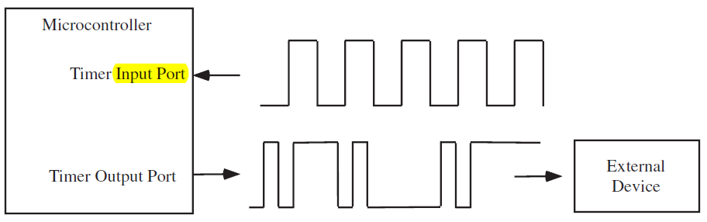
Time is “money”
An embedded system has to preform various time-related tasks
Recording the time when an event occurs
Calculating the time difference between two events
Performing tasks at specific or periodic time instants
Creating accurate time delays
Generating waveforms of certain shape, period or duty cycle

Slide 4
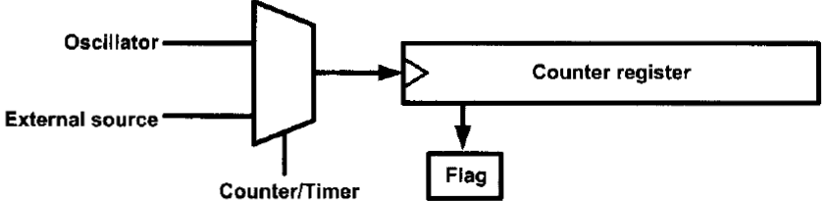

Software technique?
Can we use CPU to do these tasks?
Yes!
But…
CPU will be busy
Timing will not be accurate
Need something special?
Hardware technique $1μS×2^{16}=x$

Slide 5
PROBLEM DELAY_MS
If an ISR is fired during the execution of a delay_ms(),
ISR will be serviced first, then delay will continue
Resulting in more delay than specified
For example,
If you call _delay_ms(1) and some ISR occurs that take 200us to be serviced, _delay_ms(1) takes 1.2ms

Slide 6
Overview
ATmega32 has 3 timers
Timer 0, 1, 2
Timer 1 has the most functionalities
Each timer is associated with
A counter
A clock signal
Internal
External

Slide 7
Overview
When the internal system clock is used, a prescaler can be used to make the timer count at a slower rate
Example:
Suppose the system clock rate = 1Mhz (1μs per cycle).
Suppose a timer prescaler of 64 is used.
Then, timer will increment every 64μs.

Slide 8
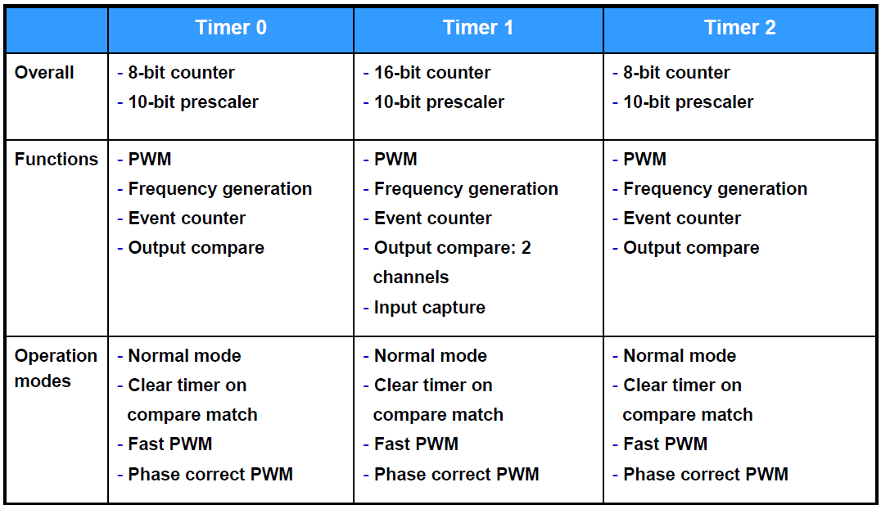

Slide 9
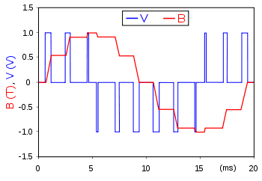
PWM
Pulse Width Modulation
A technique for getting analog results with digital means.
An example of PWM in an idealized inductor driven by a ■ voltage source modulated as a series of pulses, resulting in a ■ sine-like current in the inductor.

Slide 10
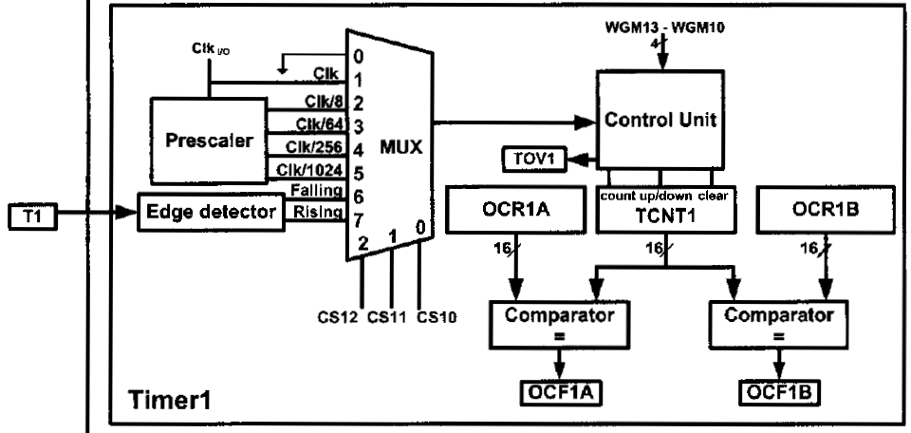
Timer 1

Slide 11
Timer 1
16 bit counter
prescaler: 8, 64, 256, 1024
Can trigger a timer overflow interrupt
and other things.. We will learn those in the subsequent lectures
Can trigger an input capture interrupt when an event occurs on the input capture pin
timer value is stored automatically in a register.
input capture pin for Timer 1 is ICP1 (D.6)

Slide 12
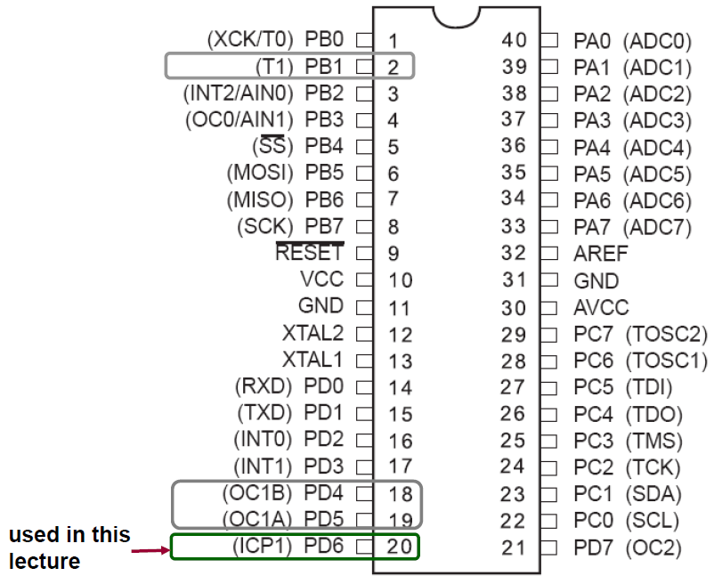
Timer 1 – Relevant pins

Slide 13
Related Registers – Timer1
TIMER/COUNTER1
TCNT1
16 bit register that stores the current value of the counter
Timer/Counter 1 Control Registers
TCCR1A and TCCR1B
To configure the operations of Timer 1.
Interrupt registers
TIMSK to enable timer interrupts
TIFR to monitor status of timer interrupts

Slide 14
Related Registers – Timer1
4. Input Capture Register
- ICR1
- to store timer value when an event occurs on input capture pin
5. Output Compare Registers

Slide 15
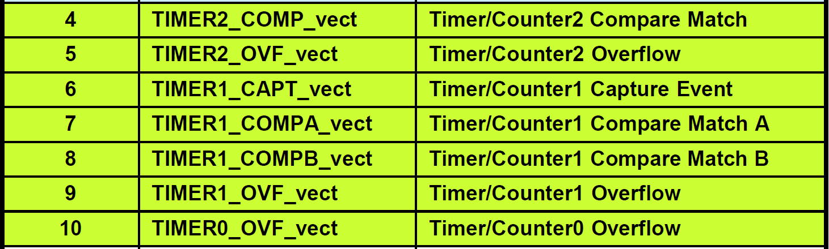
Timer related interrupts

Slide 16
Today’s mission
Creating an accurate delay using timer overflow interrupt
Measuring elapsed time between two events

Slide 17
Let’s start!!!

Slide 18
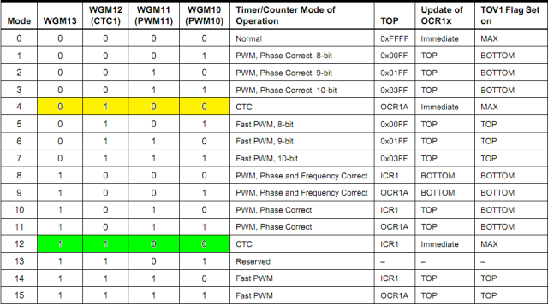
MODES

Slide 19
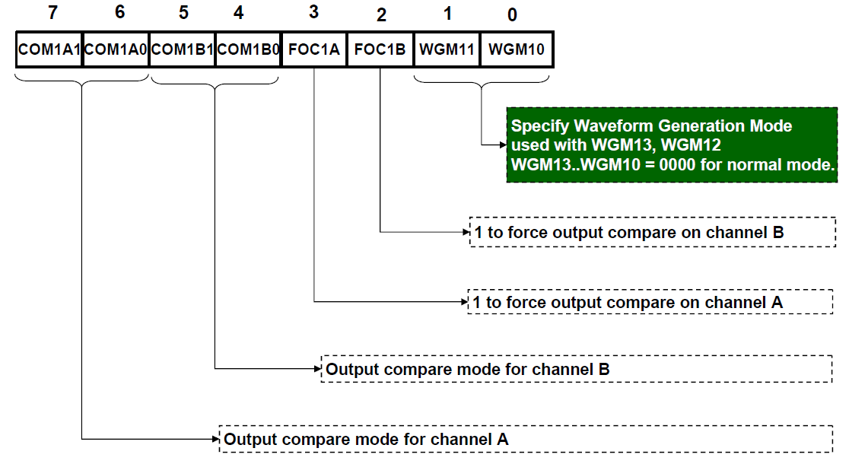
Timer/Counter 1 Control Register A (TCCR1A)

Slide 20
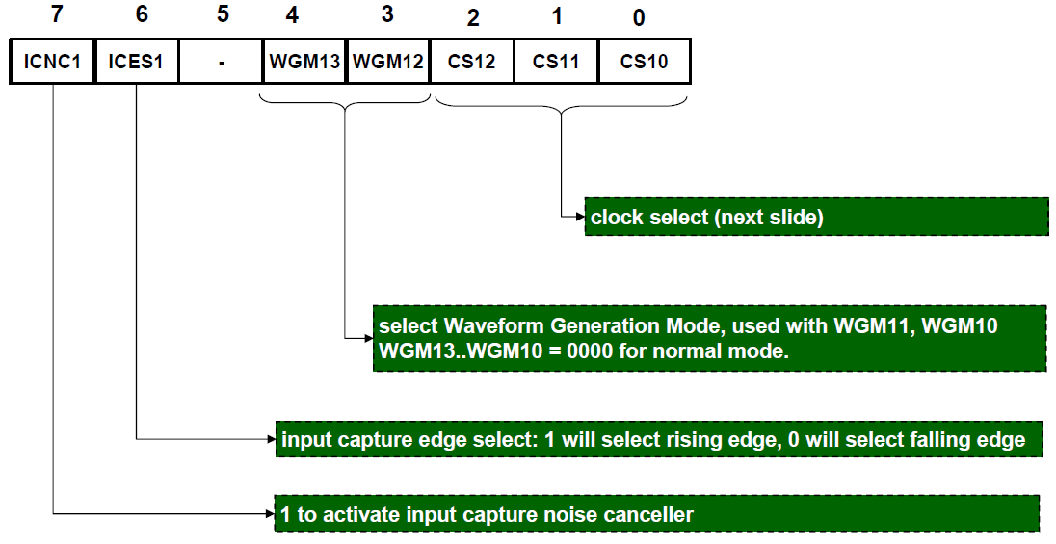
Timer/Counter 1 Control Register B (TCCR1B)

Slide 21
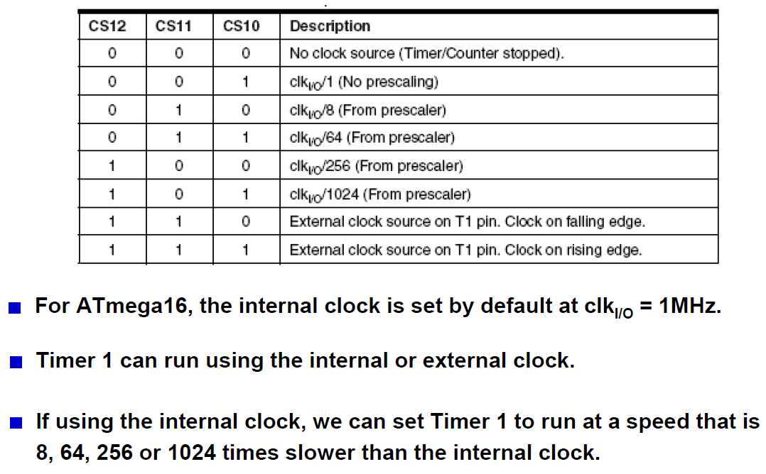
Clock select

Slide 22
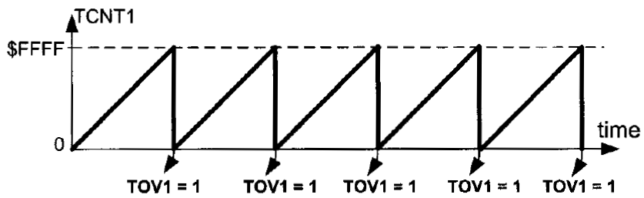
Normal mode

Slide 23
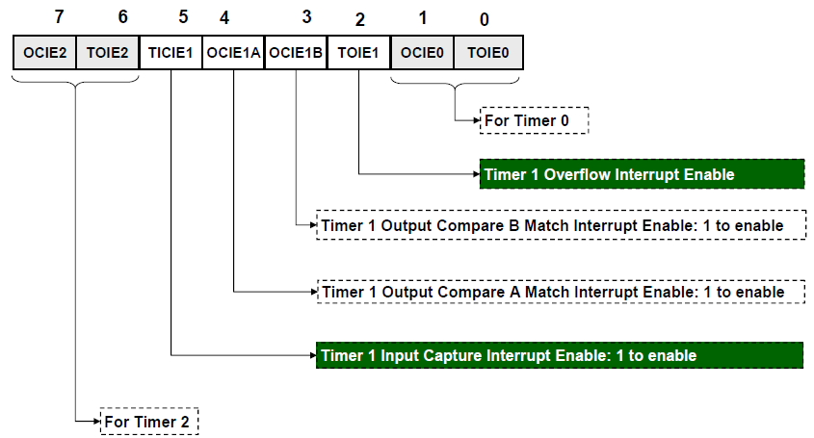
Timer/Counter Interrupt Mask Register (TIMSK)

Slide 24
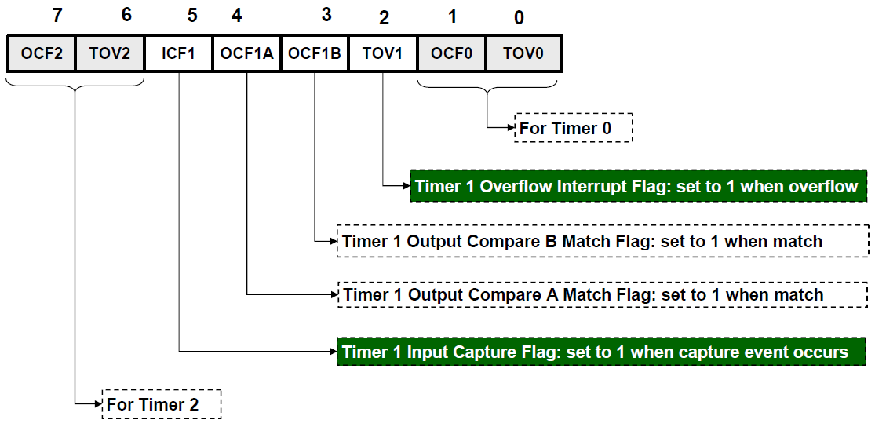
Timer/Counter Interrupt Flag Register (TIFR)

Slide 25
Write a C code to toggle PORTB every 2 seconds using TIMER 1 Overflow Interrupt

Slide 26
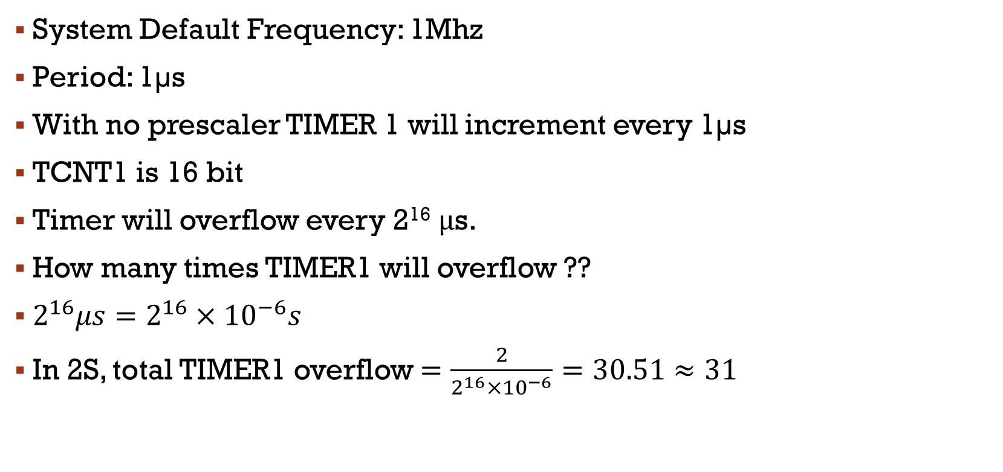
Creating an accurate delay of 2s
System Default Frequency: 1Mhz
Period: 1µs
With no prescaler TIMER 1 will increment every 1µs
TCNT1 is 16 bit
Timer will overflow every 2¹⁶ μs.
How many times TIMER1 will overflow ??
$2^{16}μs=2^{16}×{10}^{−6}s$
In 2S, total TIMER1 overflow $=\frac{2}{2^{16}×{10}^{−6}}=30.51≈31$

Slide 27
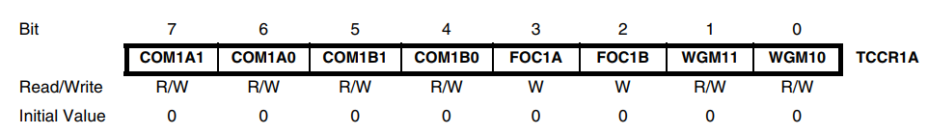
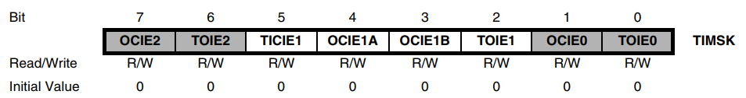
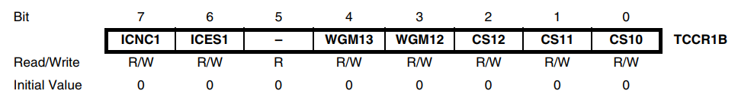
#include <avr/io.h>
#include <avr/interrupt.h>
volatile int overflowCount;
ISR(TIMER1_OVF_vect)
{
overflowCount++;
if(overflowCount==31)
{
PORTB = ~PORTB;
overflowCount = 0;
}
}
int main(void)
{
overflowCount = 0;
DDRB = 0xFF;
PORTB = 0xFF;
//configure timer
TCCR1A = 0b00000000; // normal mode
TCCR1B = 0b00000001; // no prescaler, internal clock
TIMSK = 0b00000100; //Enable Overflow Interrupt
sei(); //Global Interrupt Enable
while(1);
}

Slide 28
Appendix
Why volatile variable?
http://www.avrfreaks.net/forum/whats-volatile-variable

Slide 29
Measure the time for a demo C Code to execute

Slide 30
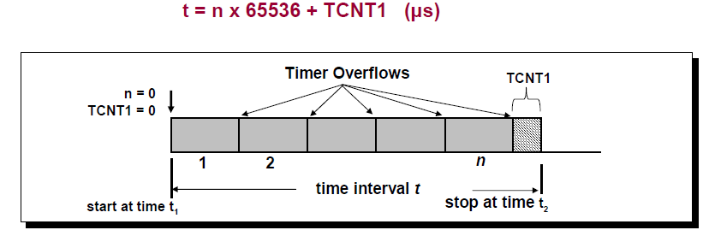
Measuring elapsed time
When no prescalling

Slide 31
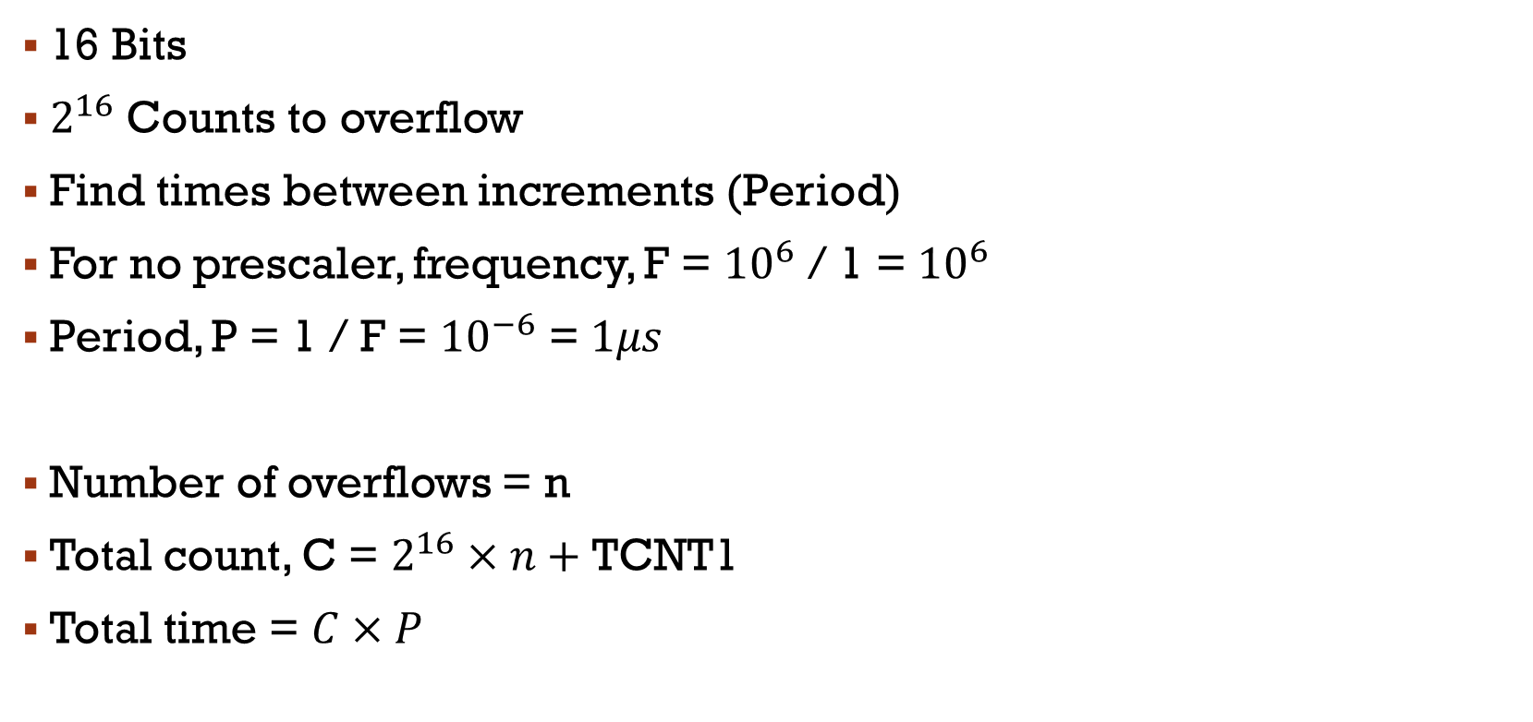
Measuring elapsed time
16 Bits
$2^{16}$ Counts to overflow
Find times between increments (Period)
For no prescaler, frequency, F = ${10}^{6}$ / 1 = ${10}^{6}$
Period, P = 1 / F = ${10}^{−6}$ = $1μs$
Number of overflows = n
Total count, C = $2^{16}×n+$ TCNT1
Total time = $C×P$

Slide 32
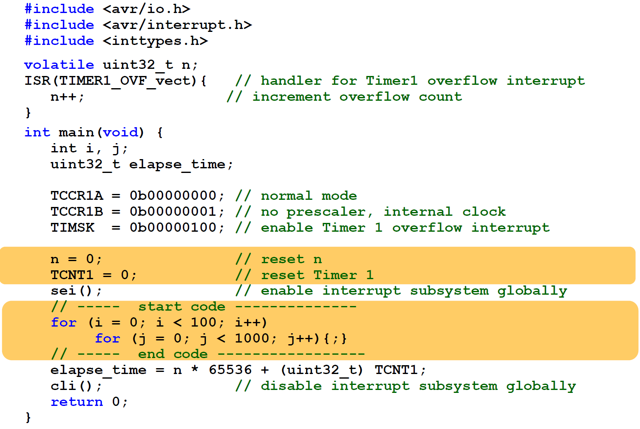
// In micro seconds

Slide 33
Measure the period of a square wave

Slide 34
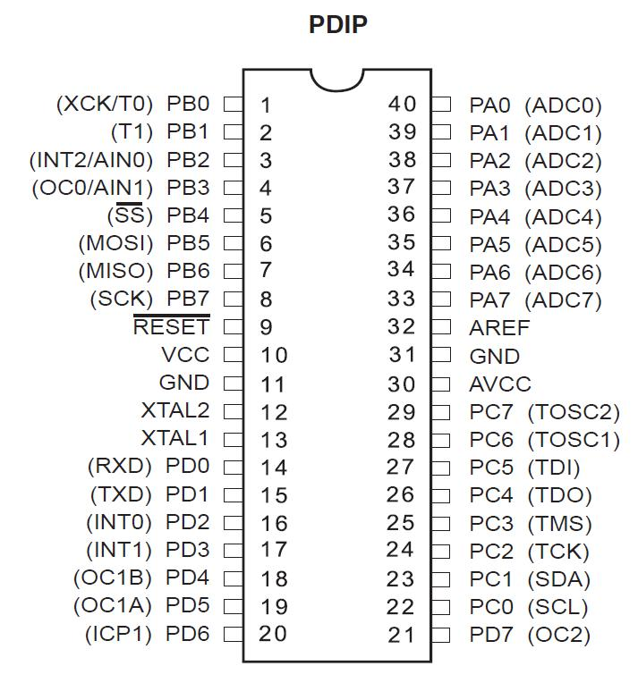
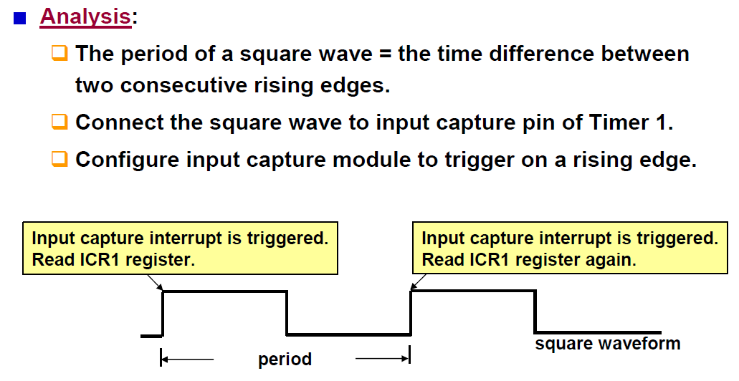
Measure period
When a capture is triggered, the 16-bit value of the counter (TCNT1) is written to the Input Capture Register (ICR1).

Slide 35
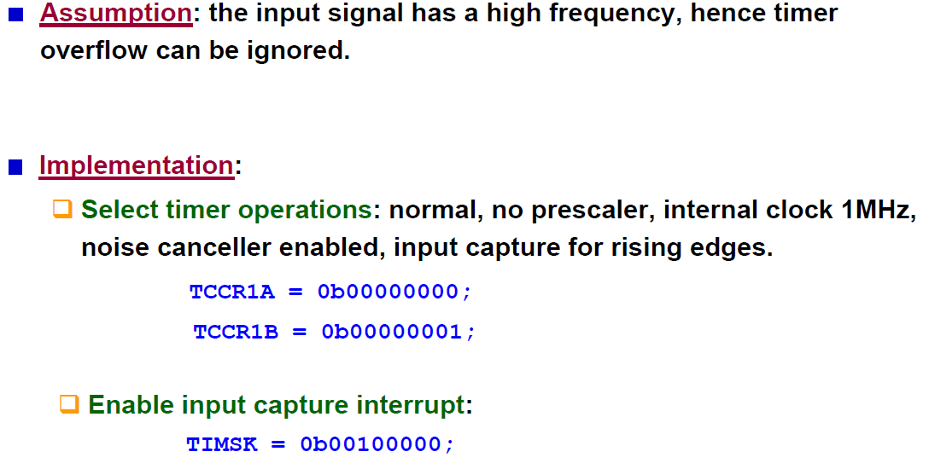
Measure period
Say, period of input signal is less than $2^{16}μs$.
TCCR1B = 0b11000001;

Slide 36
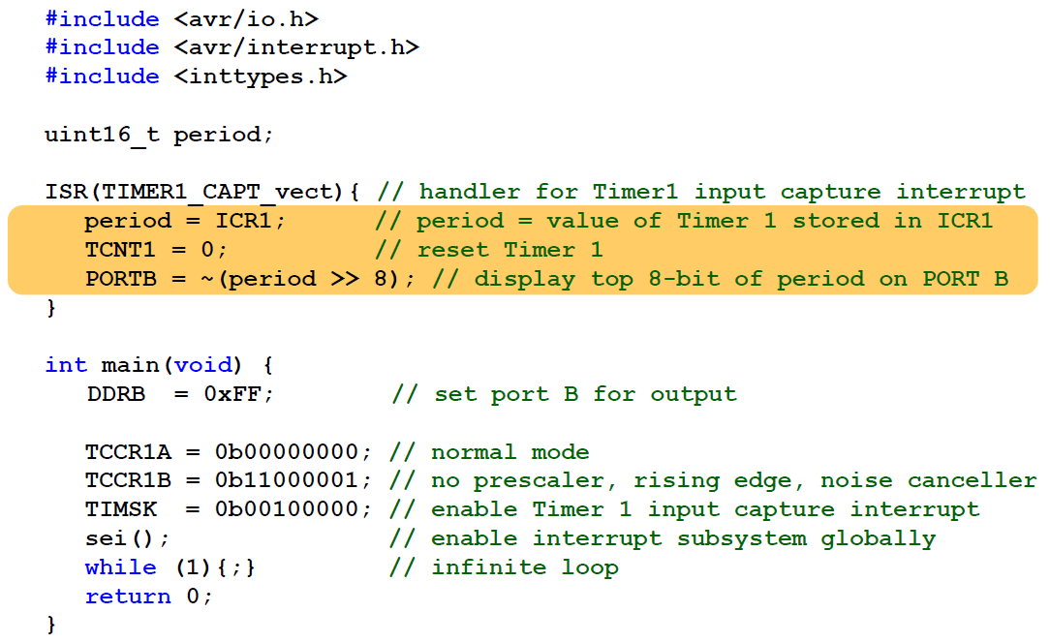
volatile uint16_t period;

Slide 37
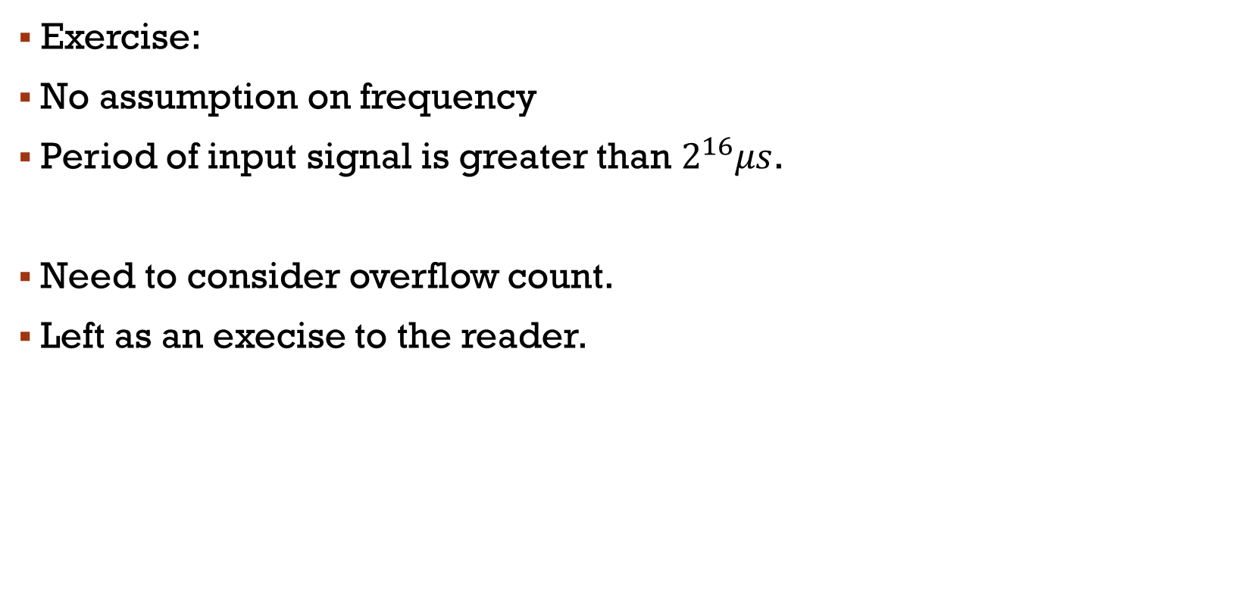
Measure the period of a square wave
Exercise:
No assumption on frequency
Period of input signal is greater than $2^{16}μs$.
Need to consider overflow count.
Left as an execise to the reader.

